Slide 1
Dairy Products
Assignment On React Js

Slide 2
Requirements :
1. Wants a milk products table webpage on react js to book the items.
2. On the top of the table needed the name (i.e. for which items belongs).
3. After the name needed the company name (XYZ Company)

Slide 3
4. There have almost 10-12 milk items/products table list .
5. Wants product list sepreted by their category and product name.
6. wants the input boxes to enter the quantity of product.
7. On submitting wants to be print the total milk quantity.
8. Also wants a delete/edit button to remove selected items.

Slide 4
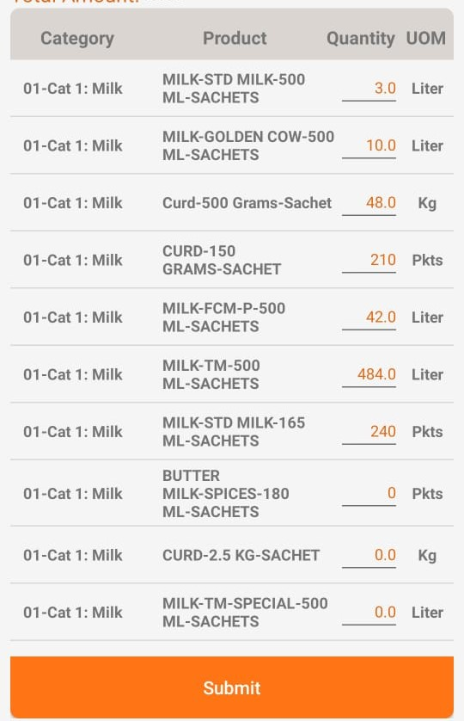
Have to design the UI like :-

Slide 5
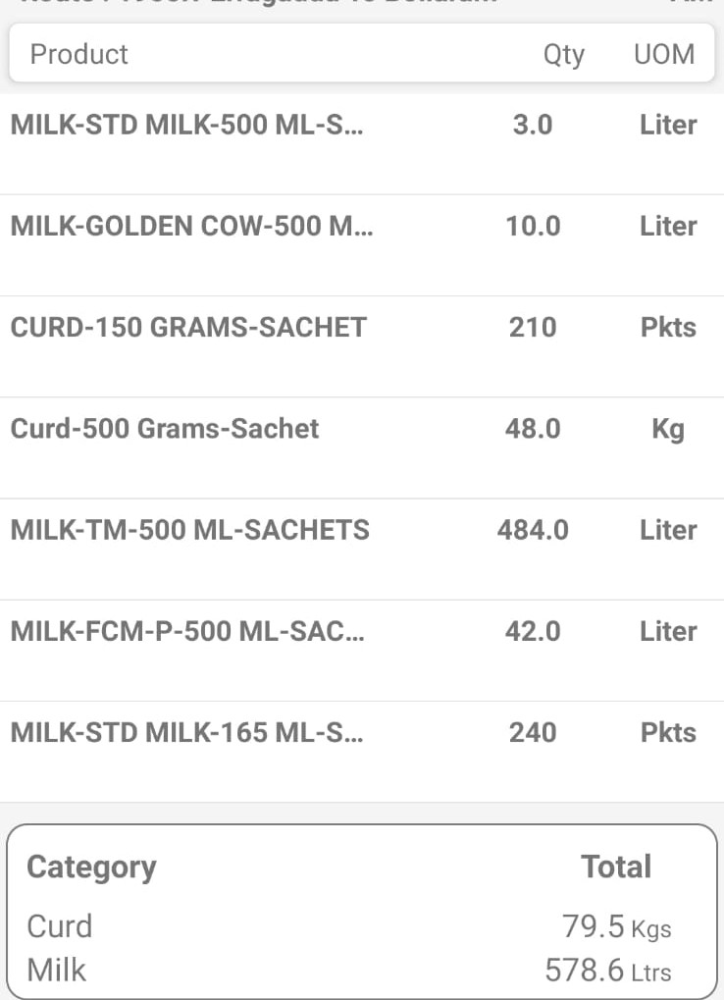
And result be like that:

Slide 6
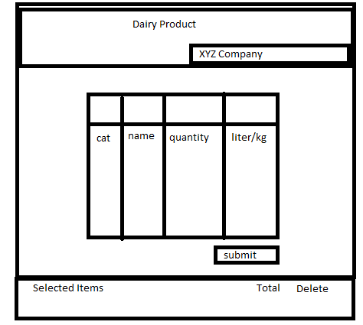
Wired Frame :-

Slide 7
Tech Stack :
Basically as the requirement there are React Js Library is Used.
1. React Js.
2. React Bootstrap => { Table, Button, etc}.
3. Javascript.
4. States. , Hooks.
5. Local Storage.
6. UseEffect => { to set data in local storage},etc.

Slide 8
Estimated Hours To Understand Topics And Complete The Assignment:-
16-18 Working Hours

Slide 9
Problems Faced and Solution :
Problems Faced :-
1. Quantity Boxes.
2. How to get values from quantity boxes, And set them in our data variable.
3. How to get data to show in Selected items.
4. How to show the selected items.
Solution :-
1. Added Input Boxes At there position.
2. To solve this issue Used states and to set in our data variable used setState.
3. Here I use the useEffect to store the data in local storage for get to show selected items.
4. For that I get the data from local storage at their I store , And

Slide 10
5. How to show Total of Selected items.
5. For this problem I store the selected items values in a array and use the method *1 to convert there values in number and then takes a variable and store the total of them and execute that inside our table data.

